Slide 1

IMDB Movie Review Analysis
BY-
Adarsh gupta
Sri Krishna
Ayush raizada

Slide 2
OBJECTIVE
Our goal is to analyse the sentiment of any user through their reviews for any movie.
It may be useful for users in their decision-making process to choose the next movie to watch if a movie also comes with an (expected) emotion signature or an emotion map.
Towards goal 1, we can build automated software tools that
(i) Analyse movie reviews and ratings, and
(ii) Provide an emotional signature from the reviews and ratings of any movie.

Slide 3
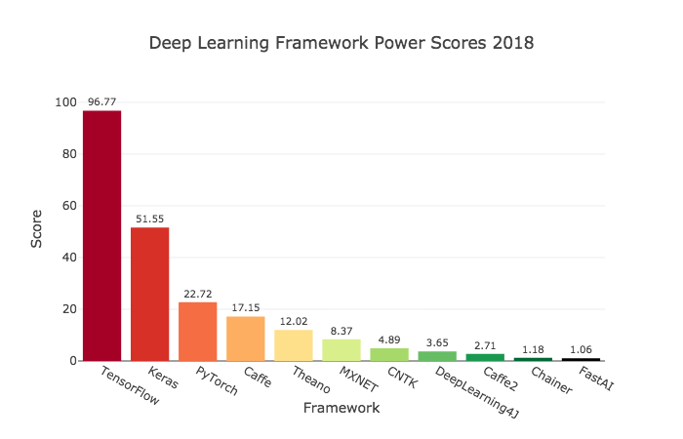
Libraries
1.TensorFlow
TensorFlow is a free and open-source software library for dataflow and differentiable programming
is a symbolic math library, and is also used for machine learning applications such as neural networks
Usage-
Tensorflow library incorporates different API to build at scale deep learning architecture like CNN or RNN

Slide 4
2. Keras
It is a sub library of TensorFlow
We are using keras and underlying deep learning models to perform data cleaning, normalization and predictions
It offers a higher-level, more intuitive set of abstractions that make it easy to develop deep learning models regardless of the computational backend used
3. NLTK
NLTK is a leading platform for building Python programs to work with human language data.
It has a suite of text processing libraries for classification, tokenization, stemming, tagging, parsing, and semantic reasoning,
wrappers for industrial-strength NLP libraries.

Slide 5
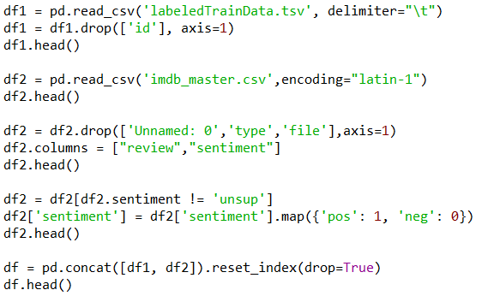
Code Snippets
1. Loading The datasets
File descriptions:
labeledTrainData - The labelled training set. The file is tab-delimited and has a header row followed by 25,000 rows containing an id, sentiment, and text for each review.
testData - The test set. The tab-delimited file has a header row followed by 25,000 rows containing an id and text for each review.
Your task is to predict the sentiment for each one.
unlabeledTrainData - An extra training set with no labels. The tab-delimited file has a header row followed by 50,000 rows containing an id and text for each review.
sampleSubmission - A comma-delimited sample submission file in the correct format.

Slide 6
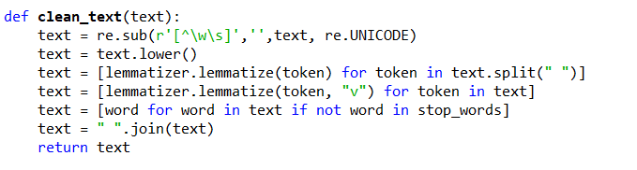
2. Data Cleaning
Clean Text function takes text as input from review.
Lemmatizer links words with similar meaning to one word, so that similar words can be analyzed as a single word.
Stop Words in NLTK help remove useless words such as “A, An, The” etc. that do not have much impact on the sentiment.

Slide 7
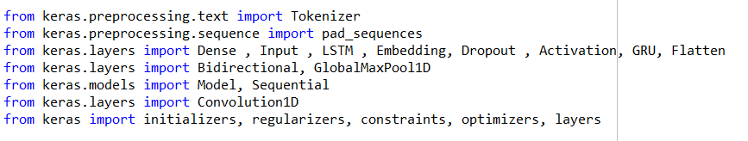
3. Importing Keras Libraries
Tokenizer is used for text preprocessing,it works by turning each text into either a sequence of integer.
We are using Bidirectional LSTM and 1DGlobal Max Pooling to create an efficient network.
We are using the Sequential model in keras which takes sequence of data.

Slide 8
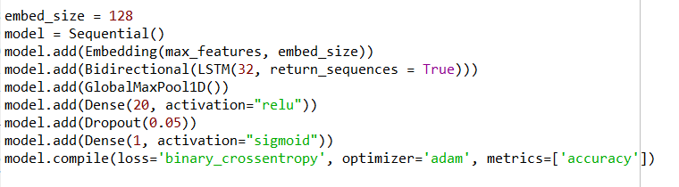
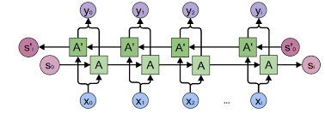
4.Building BRNN
Using bidirectional will run your inputs in two ways, one from past to future and one from future to past and using the two hidden states combined you are able in any point in time to preserve information from both past and future.
Dense is our hidden layer and dropout is used for reducing overfitting of model

Slide 9
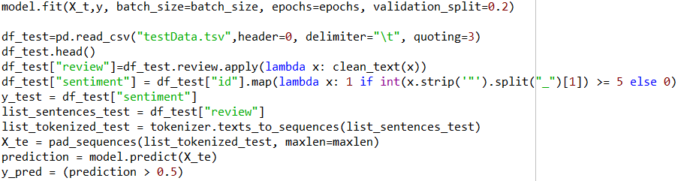
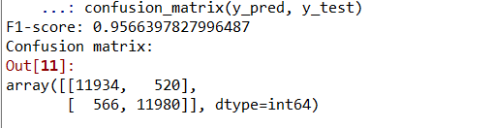
5. Fitting and predicting Data
Model is fitted to tokenized data and run for 3 epochs.
The test dataset is then cleaned, tokenized and padded so as to predict using our model.
An accuracy of 94% is obtained on training the data.

Slide 10
Applications
Sentiment analysis has many applications and benefits to any business and organizations. It can be used to give a business valuable insights into how people feel about said product, brand or service.
When applied to social media channels, it can be used to identify spikes in sentiment, thereby allowing you to identify potential product advocates or social media influencers.
It can be used to identify when potential negative threads are emerging online a business, thereby allowing us to be proactive in dealing with it more quickly.
Sentiment analysis could also be applied to a corporate network, for example, by applying it to your email server, emails could be monitored for their general “tone”.

Slide 11
Conclusion
The age of getting meaningful insights from social media data has now arrived with the advance in technology. The IMDB case study gives you a glimpse of the power of Contextual Sentiment Analysis. It’s time for organizations to move beyond overall sentiment and count based metrics. Companies have been leveraging the power of data lately, but to get the deepest of the information, you have to leverage the power of AI, Deep learning and intelligent classifiers like Contextual Semantic Search and Sentiment Analysis
We have successfully predicted the sentiment of the test data set of reviews using a BiDirectional Recurrent Neural Network(LSTM) along with a 1D Convolutional Neural Network.
An accuracy of 94% was observed which is considerably higher compared to other models implemented using NLP and classifiers such as Naïve Bayes etc.

Slide 12
Thank You
Presented by
Ex Machina

